Slide 1
18CSC202J - OBJECT ORIENTED DESIGN AND PROGRAMMING Session 1 Topic : Sequence Container: Vector List

Slide 2
What is stl???
The Standard Template Library (STL) is a set of C++ template classes to provide common programming data structures and functions such as lists, stacks, arrays, etc.
It is a library of container classes, algorithms, and iterators.
It is a generalized library and so, its components are parameterized.
A working knowledge of template classes is a prerequisite for working with STL.

Slide 3
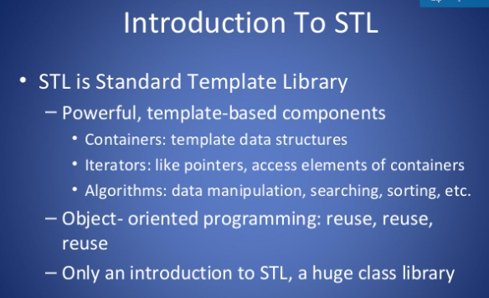

Slide 4
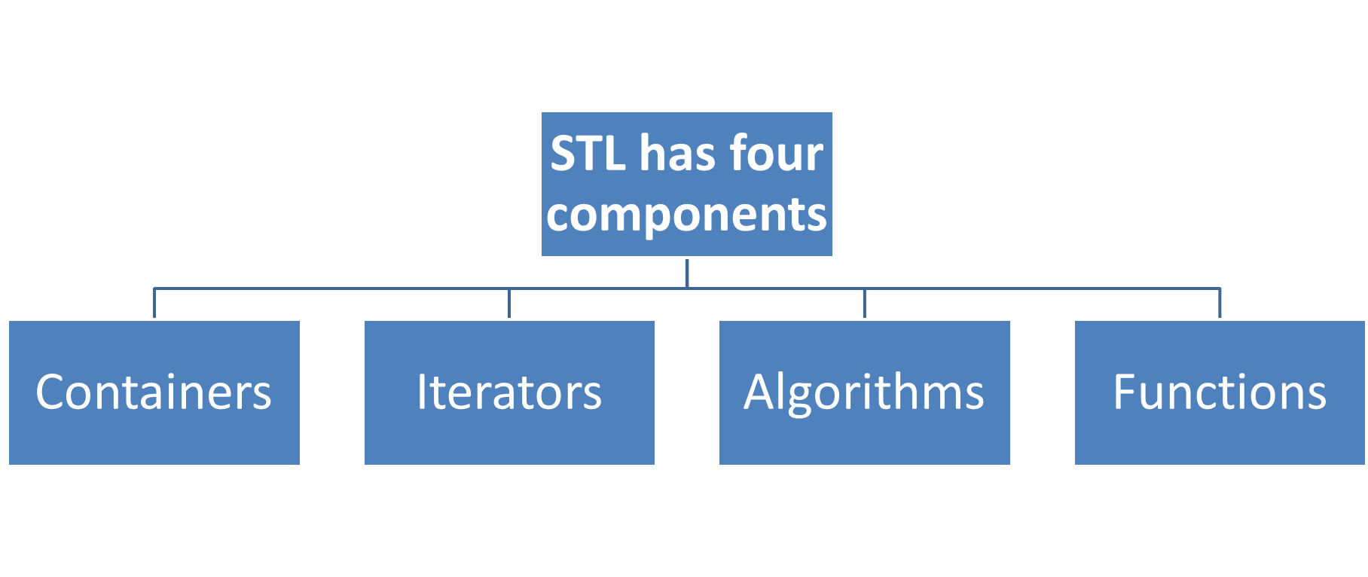

Slide 5
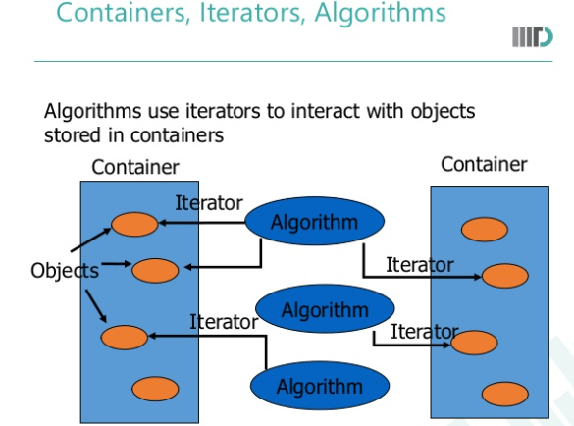

Slide 6
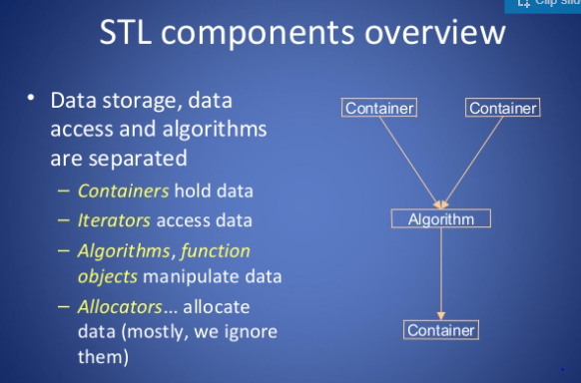

Slide 7
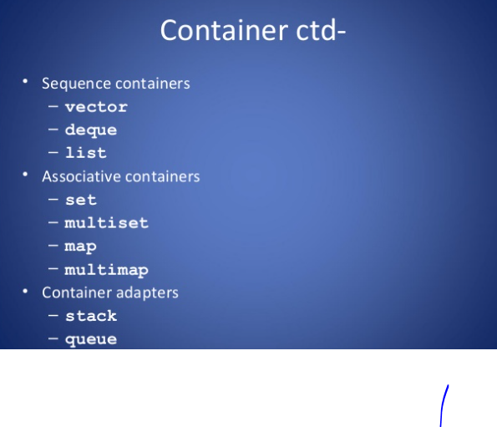

Slide 8
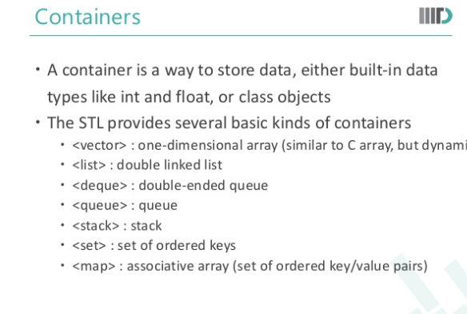

Slide 9
STL Containers
Sequence and Associative Containers

Slide 10
Containers
Containers or container classes store objects and data.
There are in total seven standard “first-class” container classes and three container adaptor classes and only seven header files that provide access to these containers or container adaptors.
Sequence Containers
Container Adaptors
Associative Containers
Unordered Associative Containers

Slide 11
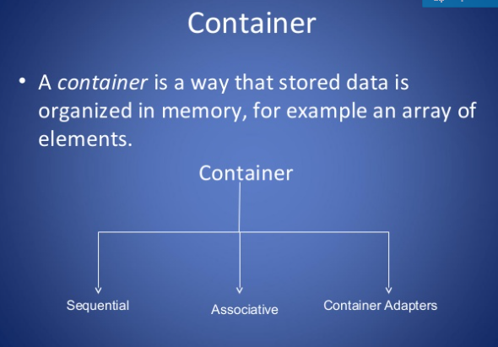

Slide 12

Sequence Containers

Slide 13
Sequence Containers: Vector
Vectors are same as dynamic arrays with the ability to resize itself automatically when an element is inserted or deleted, with their storage being handled automatically by the container.
Vector elements are placed in contiguous storage so that they can be accessed and traversed using iterators. In vectors, data is inserted at the end.
Inserting at the end takes differential time, as sometimes there may be a need of extending the array.
Removing the last element takes only constant time because no resizing happens. Inserting and erasing at the beginning or in the middle is linear in time.

Slide 14
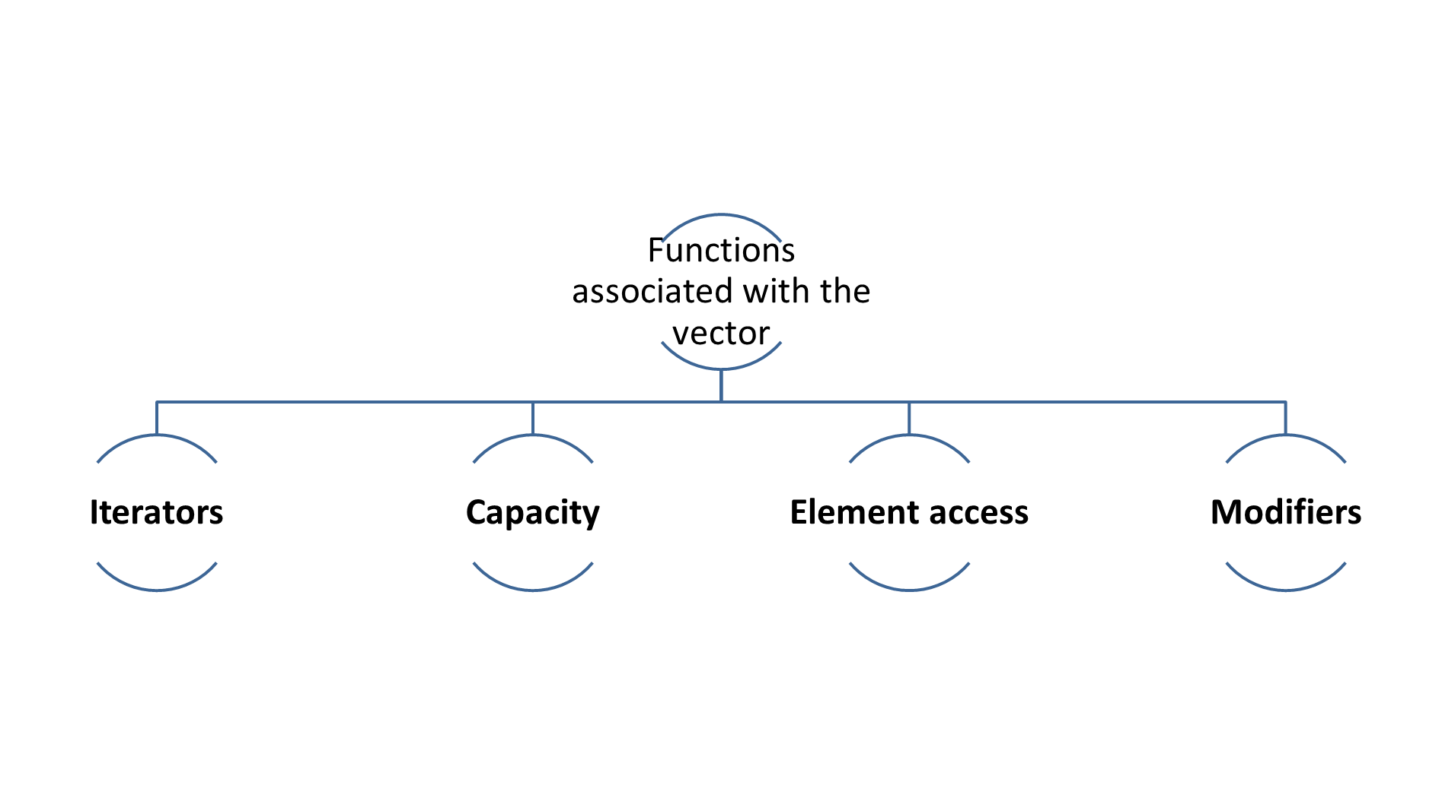

Slide 15
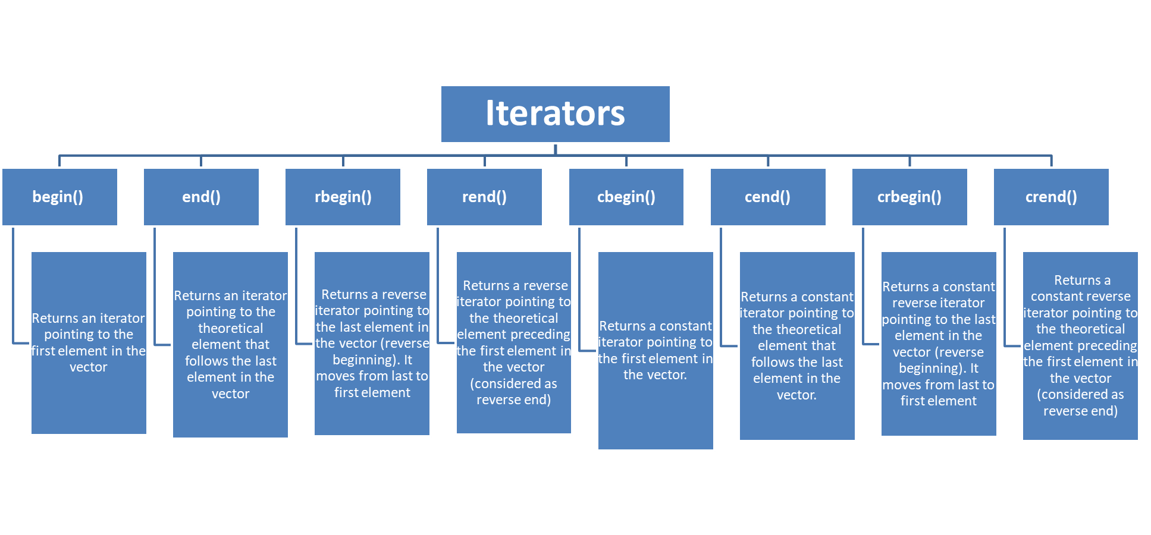
functions associated with the vector

Slide 16
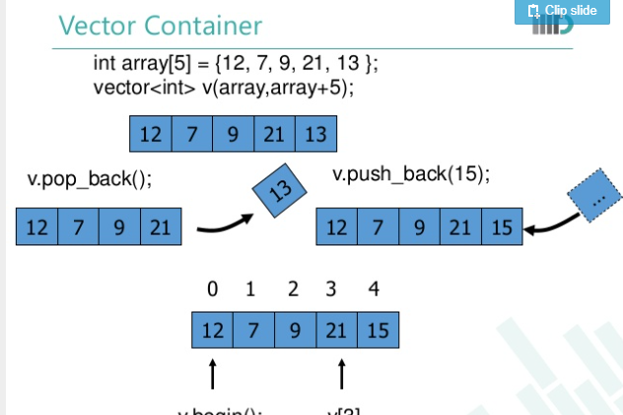

Slide 17
// C++ program to illustrate the iterators in vector
#include <iostream>
#include <vector>
using namespace std;
int main()
{
vector<int> g1;
for (int i = 1; i <= 5; i++)
g1.push_back(i);
cout << "Output of begin and end: ";
for (auto i = g1.begin(); i != g1.end(); ++i)
cout << *i << " ";
cout << "\nOutput of cbegin and cend: ";
for (auto i = g1.cbegin(); i != g1.cend(); ++i)
cout << *i << " ";
cout << "\nOutput of rbegin and rend: ";
for (auto ir = g1.rbegin(); ir != g1.rend(); ++ir)
cout << *ir << " ";
cout << "\nOutput of crbegin and crend : ";
for (auto ir = g1.crbegin(); ir != g1.crend(); ++ir)
cout << *ir << " ";
return 0;
}
Output:
Output of begin and end: 1 2 3 4 5
Output of cbegin and cend: 1 2 3 4 5
Output of rbegin and rend: 5 4 3 2 1
Output of crbegin and crend : 5 4 3 2 1

Slide 18
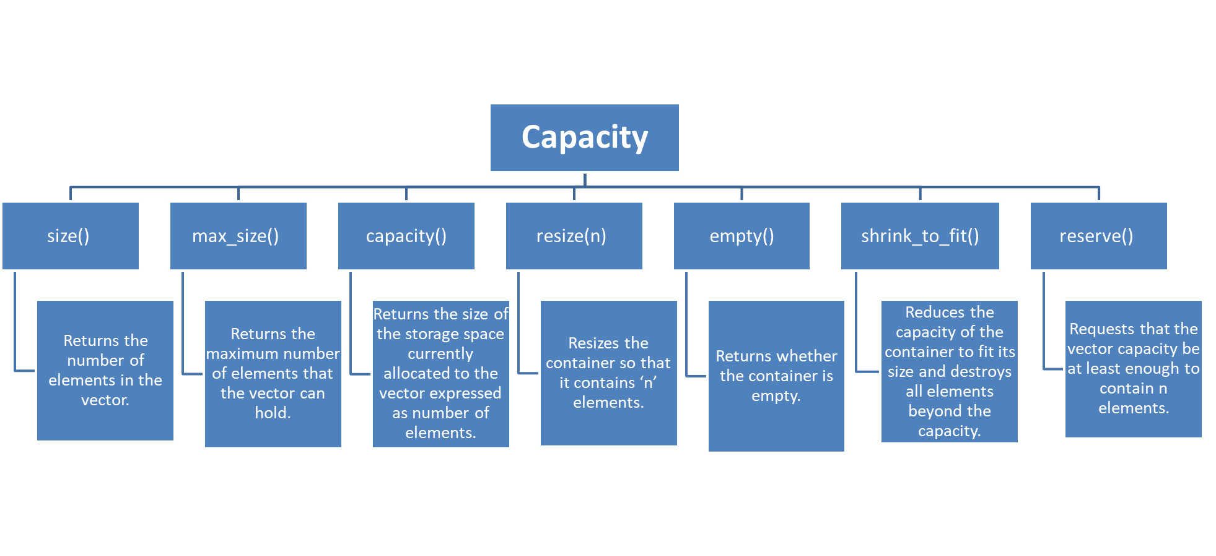
functions associated with the vector

Slide 19
// C++ program to illustrate the capacity function in vector
#include <iostream>
#include <vector>
using namespace std;
int main()
{
vector<int> g1;
for (int i = 1; i <= 5; i++)
g1.push_back(i);
cout << "Size : " << g1.size();
cout << "\nCapacity : " << g1.capacity();
cout << "\nMax_Size : " << g1.max_size();
// resizes the vector size to 4
g1.resize(4);
// prints the vector size after resize()
cout << "\nSize : " << g1.size();
// checks if the vector is empty or not
if (g1.empty() == false)
cout << "\nVector is not empty";
else
cout << "\nVector is empty";
// Shrinks the vector
g1.shrink_to_fit();
cout << "\nVector elements are: ";
for (auto it = g1.begin(); it != g1.end(); it++)
cout << *it << " ";
return 0;
}
Output:
Size : 5
Capacity : 8
Max_Size : 461
Size : 4
1686018427387903Vector is not empty
Vector elements are: 1 2 3 4

Slide 20
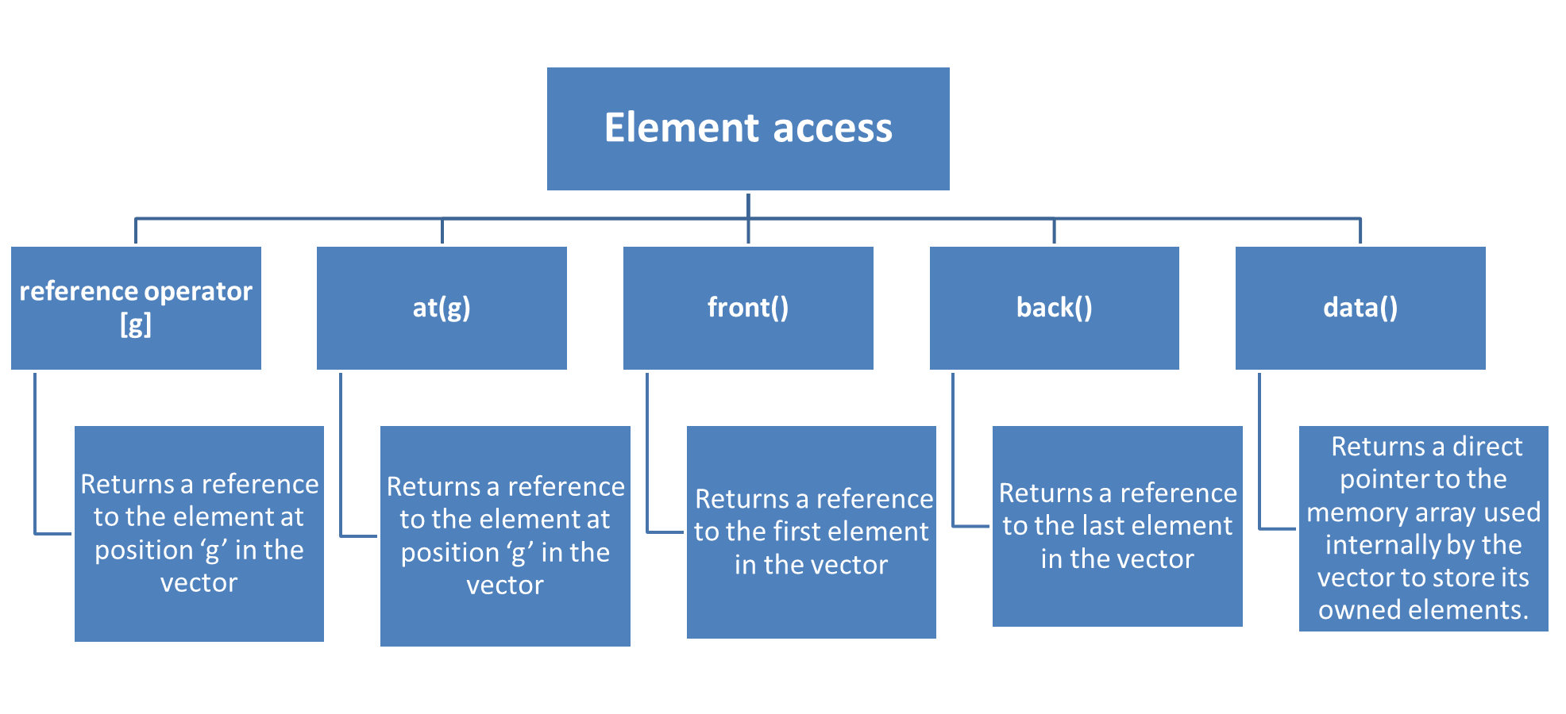
functions associated with the vector

Slide 21
// C++ program to illustrate the element accesser in vector
#include <bits/stdc++.h>
using namespace std;
int main()
{
vector<int> g1;
for (int i = 1; i <= 10; i++)
g1.push_back(i * 10);
cout << "\nReference operator [g] : g1[2] = " << g1[2];
cout << "\nat : g1.at(4) = " << g1.at(4);
cout << "\nfront() : g1.front() = " << g1.front();
cout << "\nback() : g1.back() = " << g1.back();
// pointer to the first element
int* pos = g1.data();
cout << "\nThe first element is " << *pos;
return 0;
}
Output:
Reference operator [g] : g1[2] = 30
at : g1.at(4) = 50
front() : g1.front() = 10
back() : g1.back() = 100
The first element is 10

Slide 22
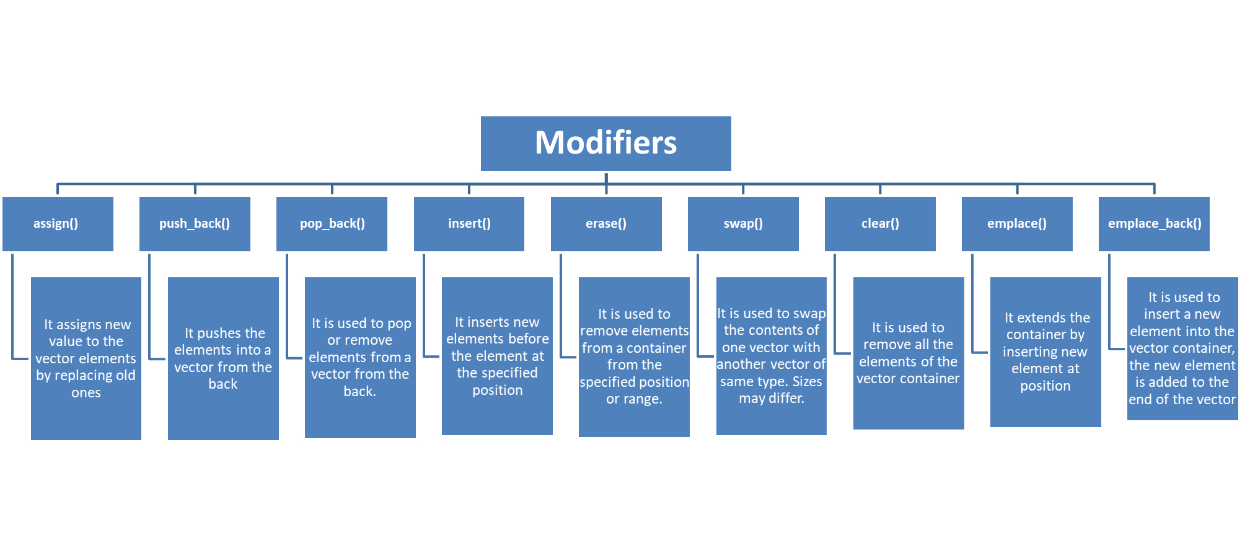
functions associated with the vector

Slide 23
Sequence Container: List
Lists are sequence containers that allow non-contiguous memory allocation.
As compared to vector, list has slow traversal, but once a position has been found, insertion and deletion are quick.
Normally, when we say a List, we talk about doubly linked list. For implementing a singly linked list, we use forward list.

Slide 24
#include <iostream>
#include <list>
#include <iterator>
using namespace std;
//function for printing the elements in a list
void showlist(list <int> g)
{
list <int> :: iterator it;
for(it = g.begin(); it != g.end(); ++it)
cout << '\t' << *it;
cout << '\n';
}
int main()
{
list <int> gqlist1, gqlist2;
for (int i = 0; i < 10; ++i)
{
gqlist1.push_back(i * 2);
gqlist2.push_front(i * 3);
}
cout << "\nList 2 (gqlist2) is : ";
cout << "\nList 1 (gqlist1) is : ";
showlist(gqlist1);
showlist(gqlist2);
cout << "\ngqlist1.front() : " << gqlist1.front();
cout << "\ngqlist1.back() : " << gqlist1.back();
cout << "\ngqlist1.pop_front() : ";
gqlist1.pop_front();
showlist(gqlist1);
cout << "\ngqlist2.pop_back() : ";
gqlist2.pop_back();
showlist(gqlist2);
cout << "\ngqlist1.reverse() : ";
gqlist1.reverse();
showlist(gqlist1);
cout << "\ngqlist2.sort(): ";
gqlist2.sort();
showlist(gqlist2);
return 0;
}

Slide 25
The output of the above program is :
List 1 (gqlist1) is : 0 2 4 6 8 10 12 14 16 18
List 2 (gqlist2) is : 27 24 21 18 15 12 9 6 3 0
gqlist1.front() : 0
gqlist1.back() : 18
gqlist1.pop_front() : 2 4 6 8 10 12 14 16 18
gqlist2.pop_back() : 27 24 21 18 15 12 9 6 3
gqlist1.reverse() : 18 16 14 12 10 8 6 4 2
gqlist2.sort(): 3 6 9 12 15 18 21 24 27

Slide 26
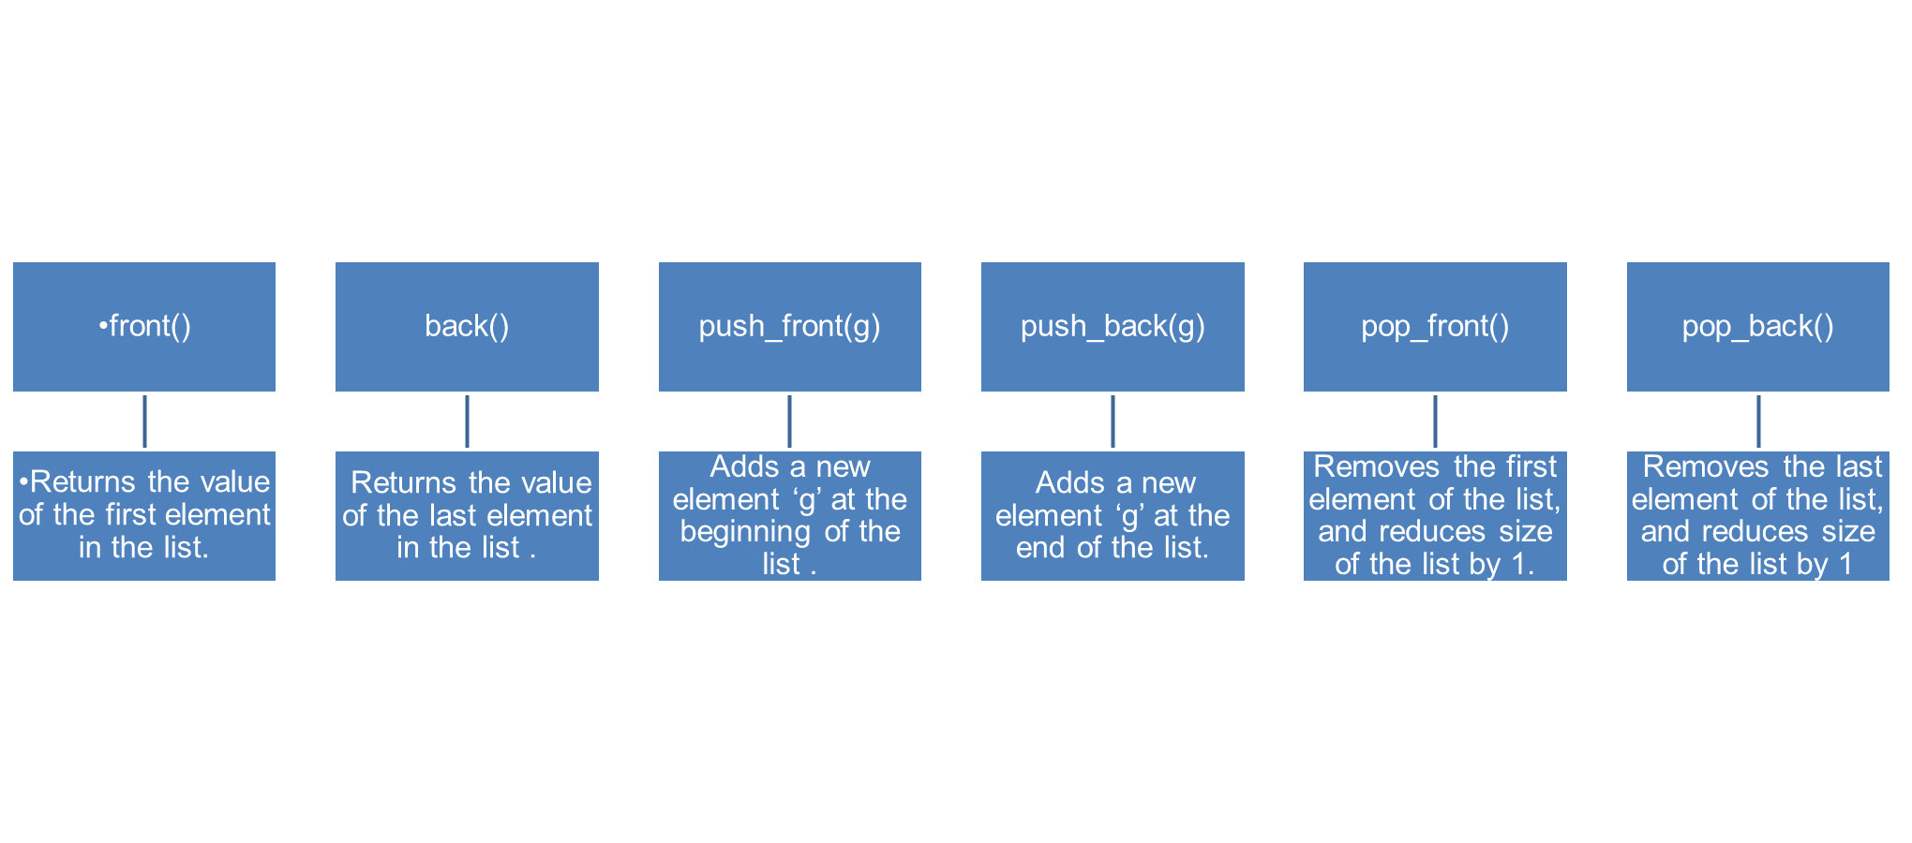
functions associated with the Lists

Slide 27
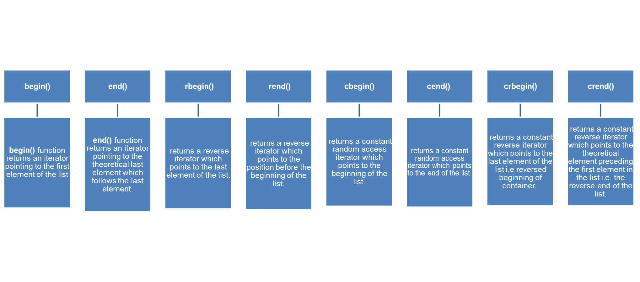
functions associated with the Lists

Slide 28
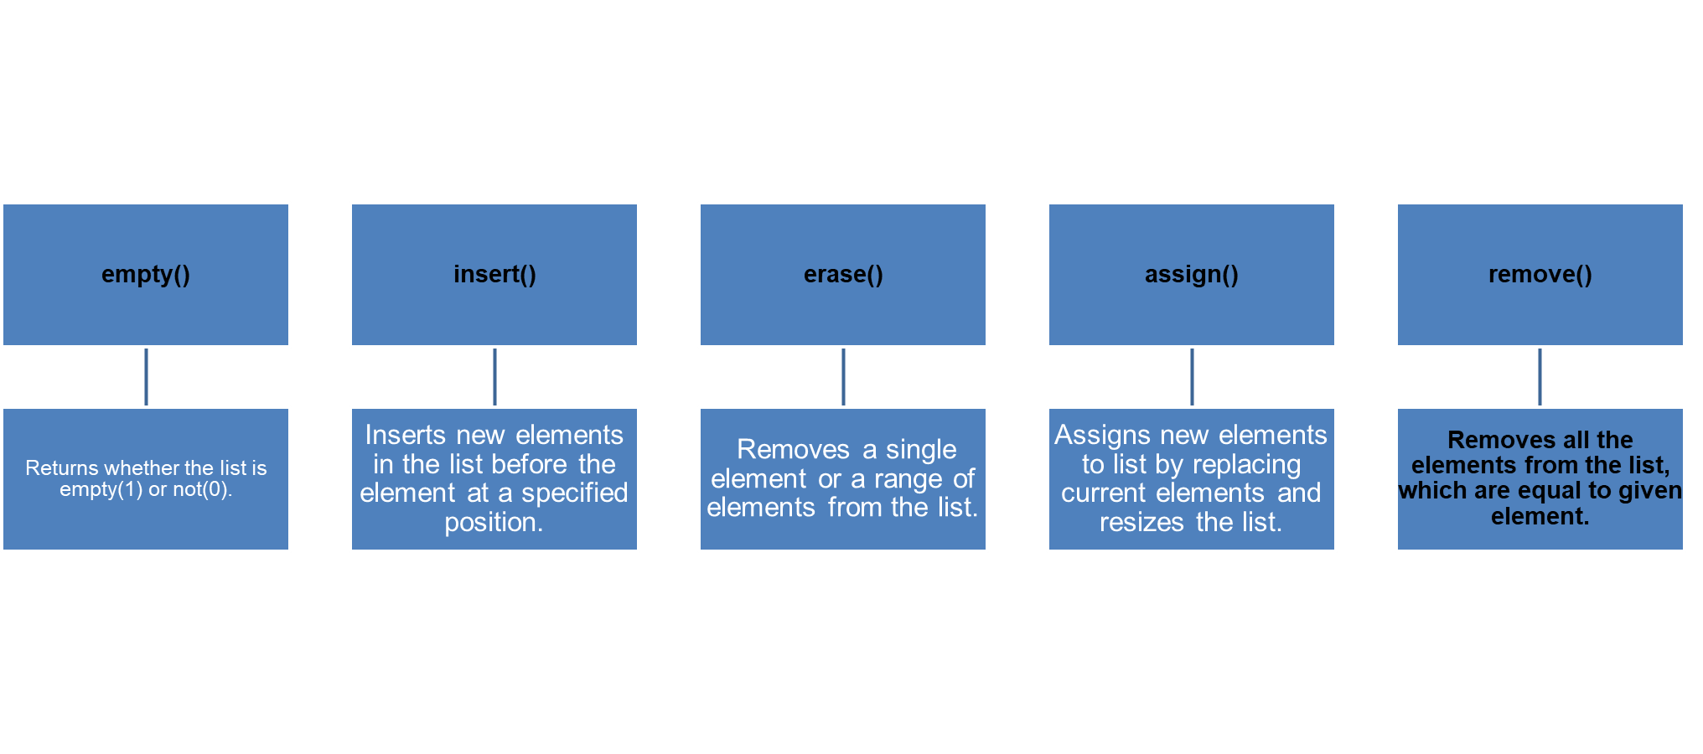
functions associated with the Lists

Slide 29
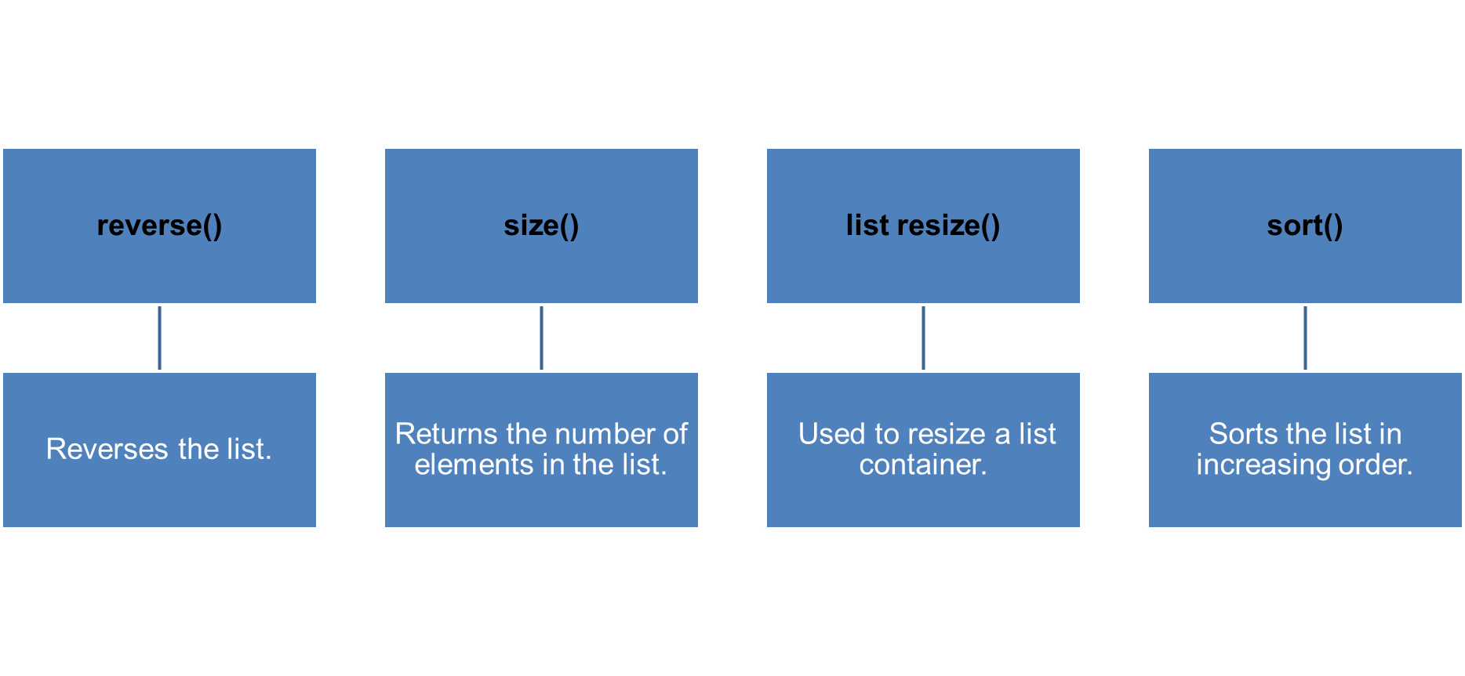
functions associated with the Lists

Slide 30
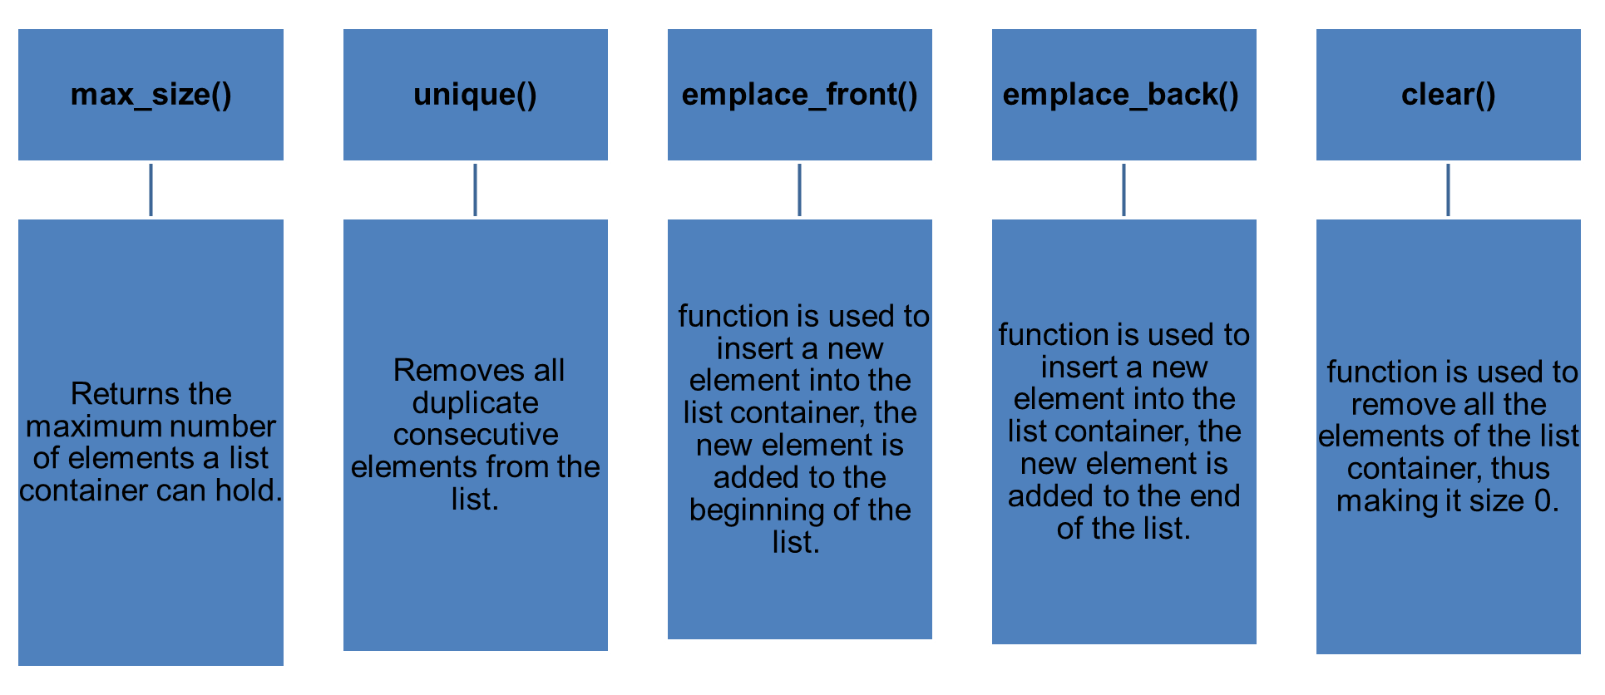
functions associated with the Lists

Slide 31
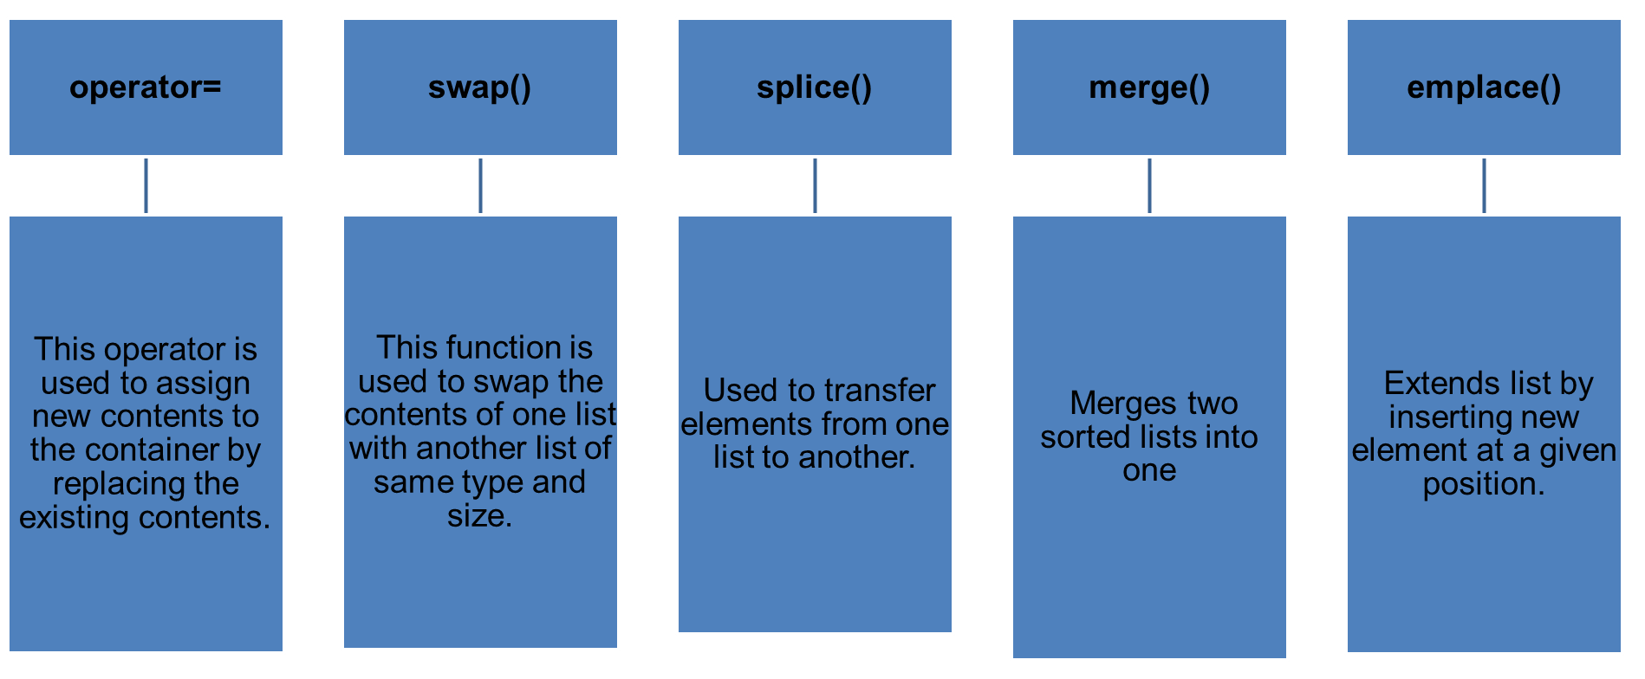
functions associated with the Lists

